Slide 1
Autonomous traffic system
Team Hoffenheim

Slide 2
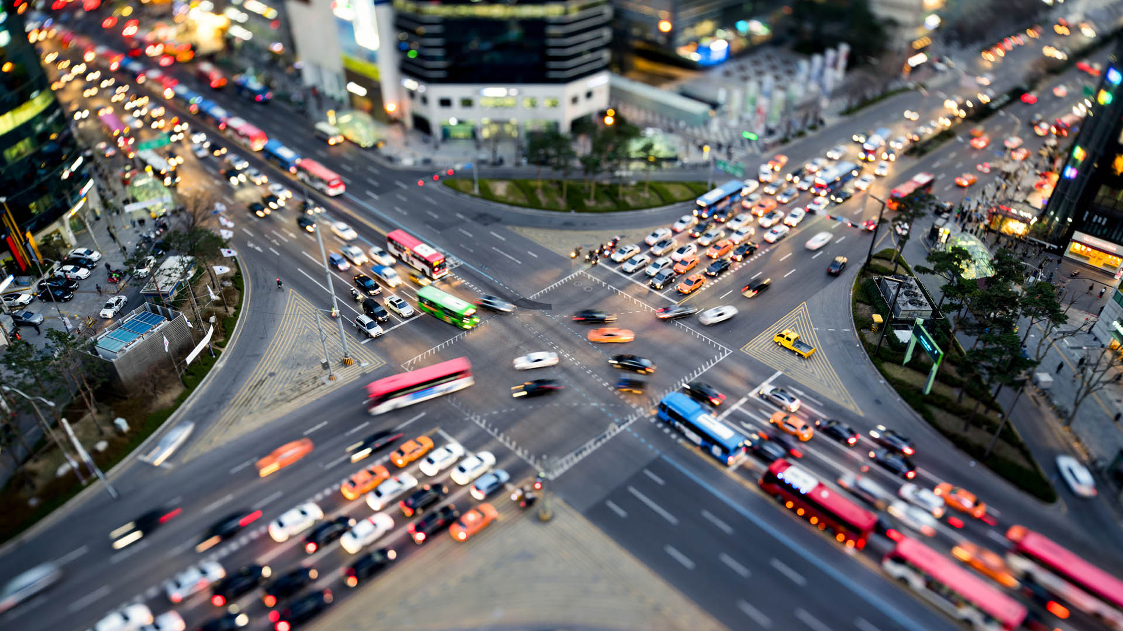
Why ?

Slide 3
How ?

Slide 4



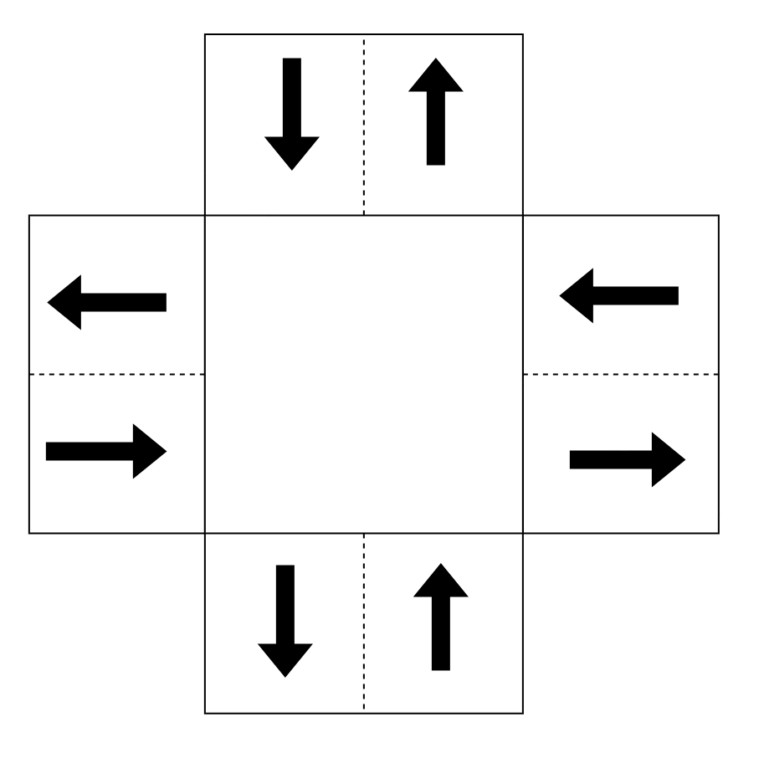
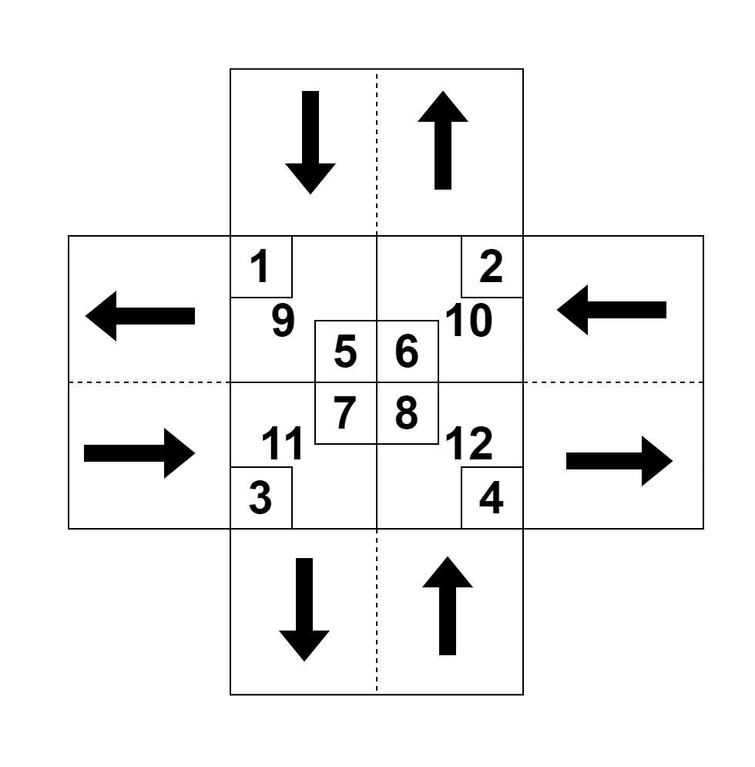

1
2
3
Autonomous traffic controller
Autonomous traffic controller

Slide 5
Approach

Slide 6
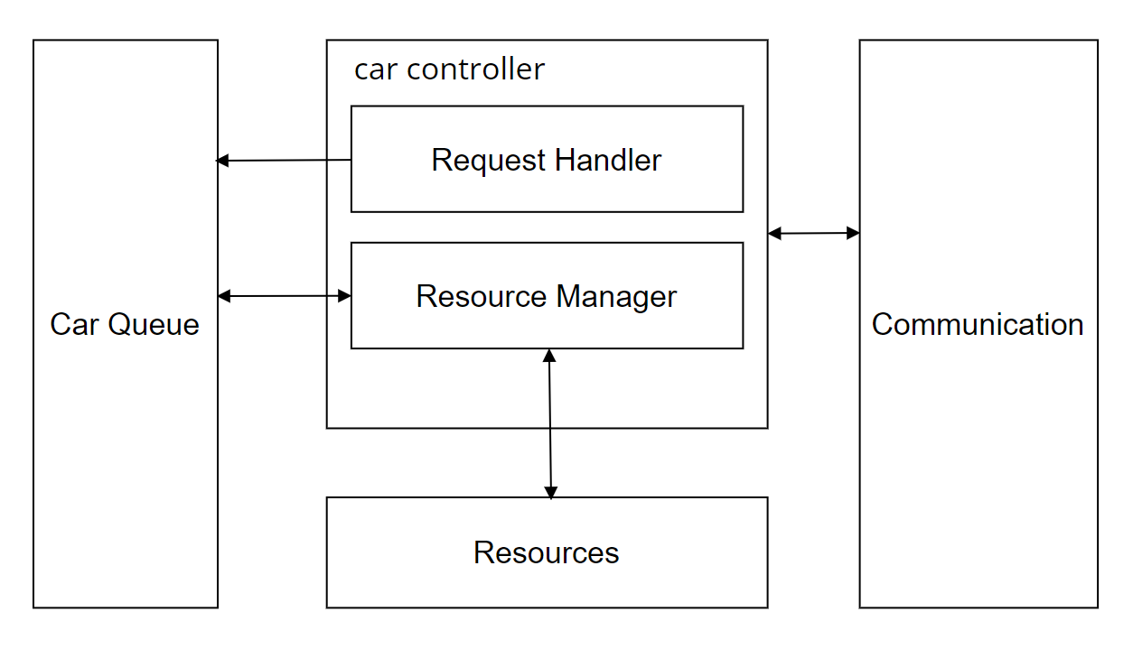
Architecture model

Slide 7
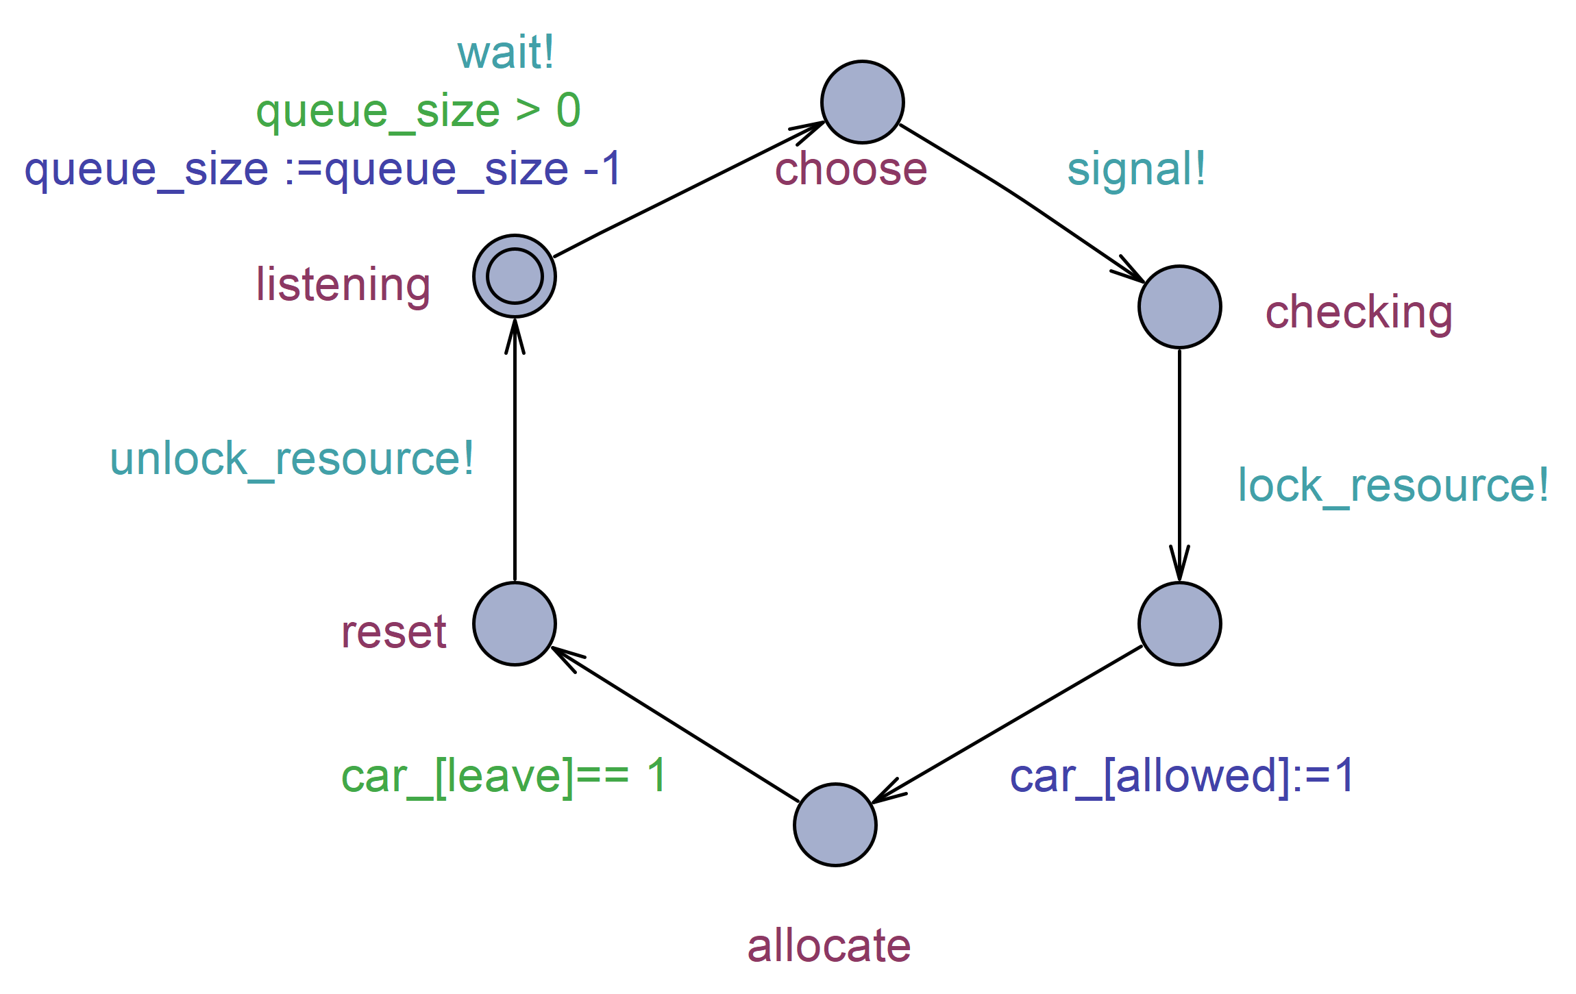
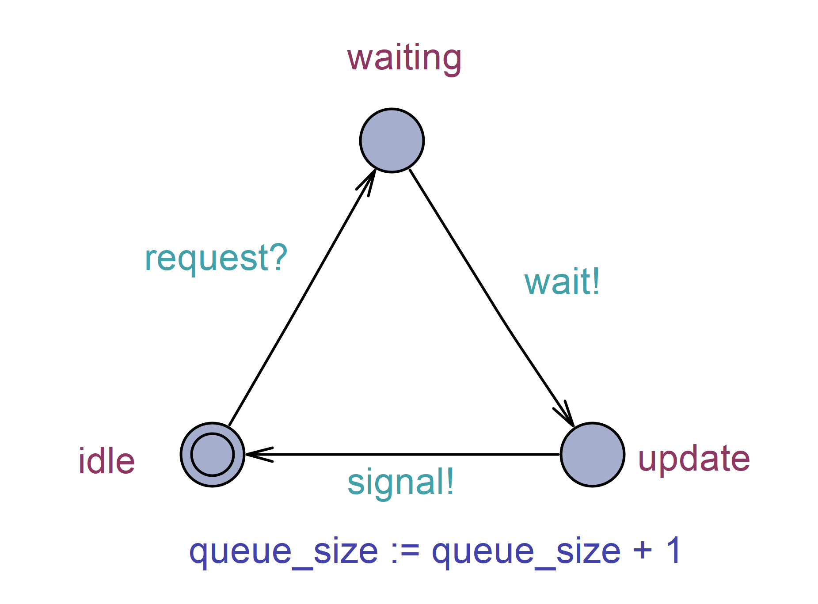
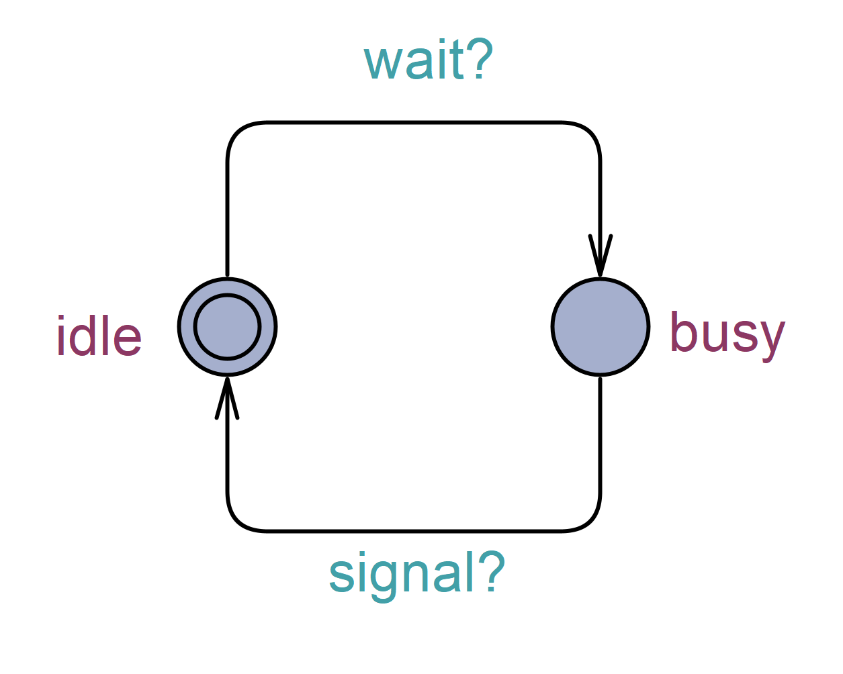
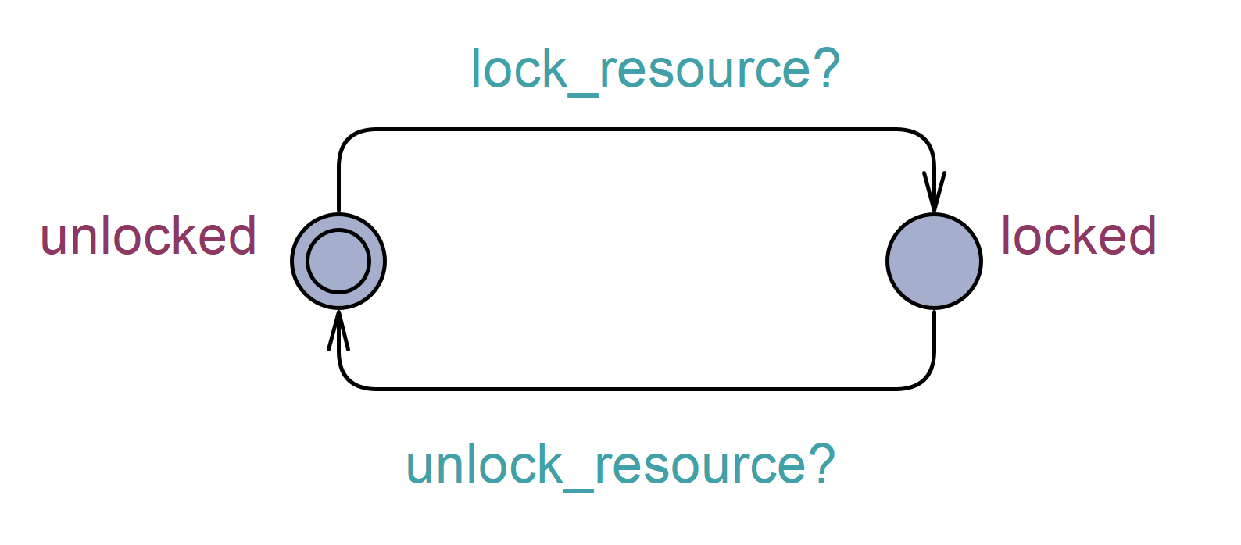
Behavioral model State Chart
Request Handler
Resource Manager
Resource
Queue

Slide 8
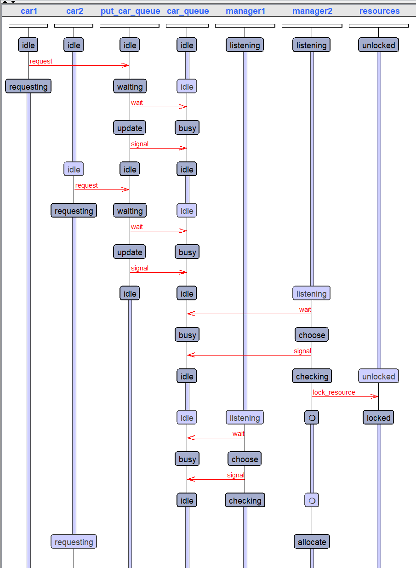
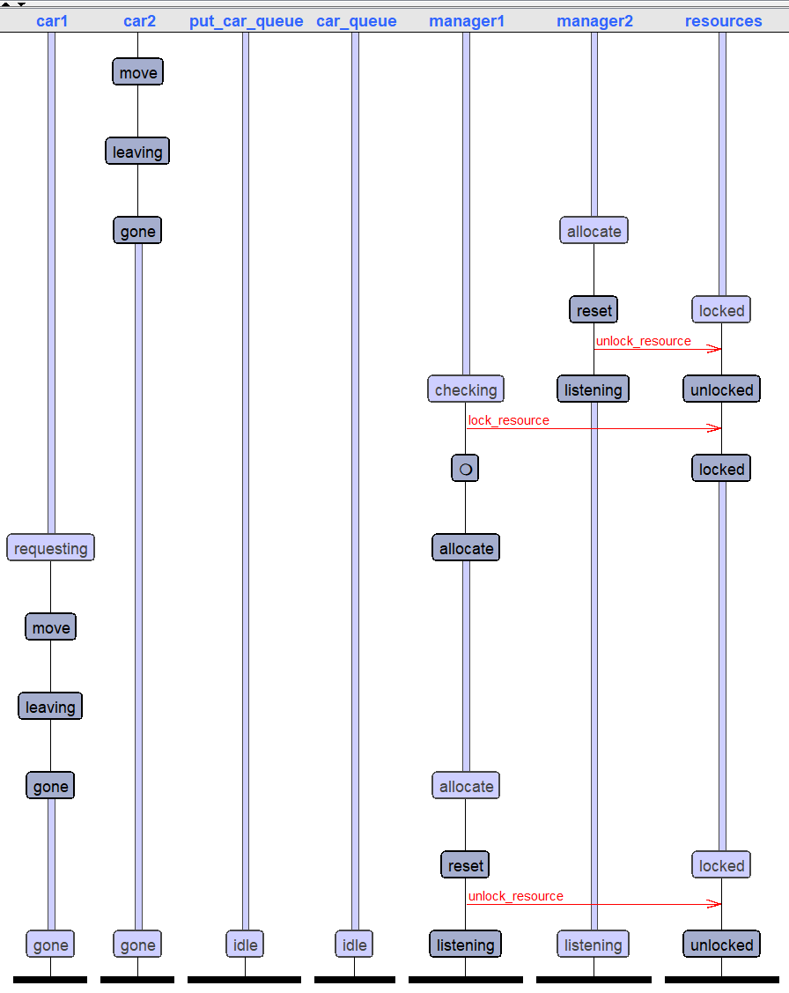
State Chart Simulation

Slide 9
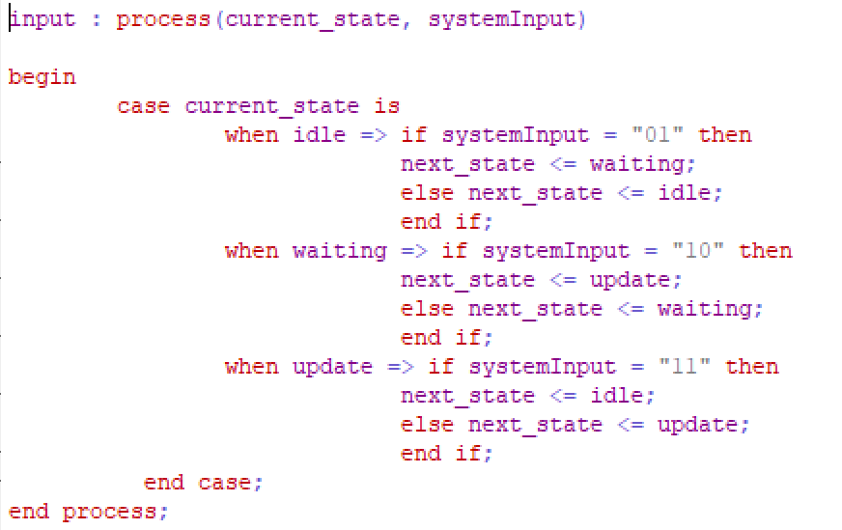
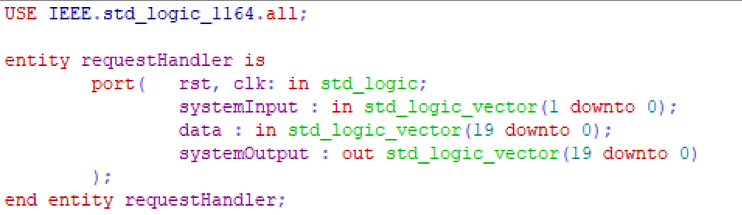
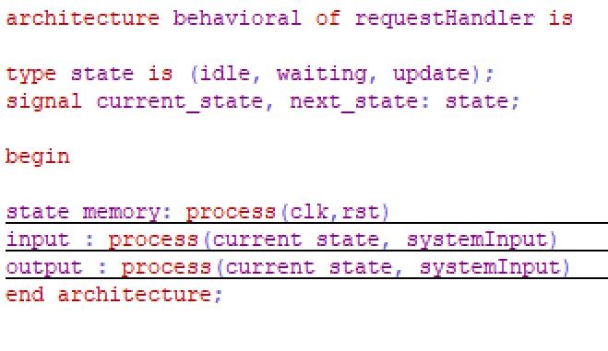
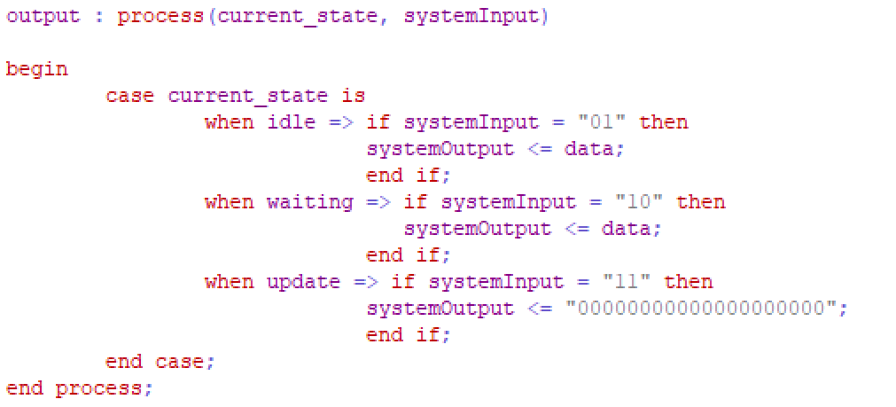
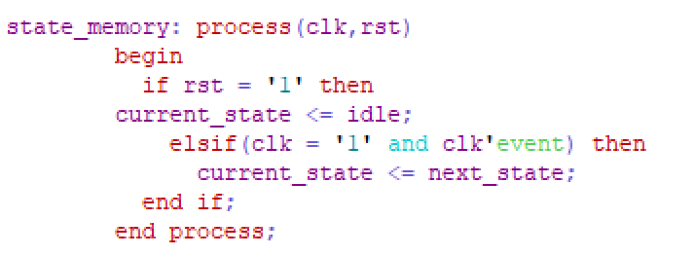
Behavioral model VHDL

Slide 10
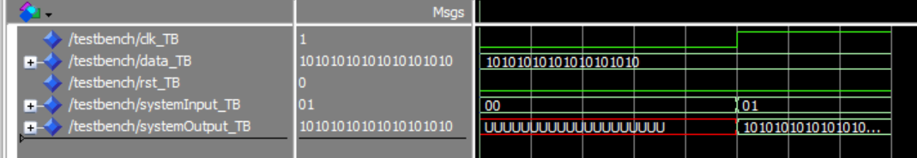
VHDL Simulation

Slide 11
The Prototype

Slide 12
RTOS on Arduino
Process
Memory
Request Handler
Resource Mananger
Resource Mananger
Resource Mananger
Queue
Resource

Slide 13
Simulation
Process
Memory
Request Handler
Resource Manager
Resource Manager
Resource Manager
Requesting car
Queue
Resource

Slide 14
Thank you

Slide 15
Reference
All model for simulation can be access here: https://github.com/Adib6637/AutonomusTraficSystemHoffenheim

